Slide 1
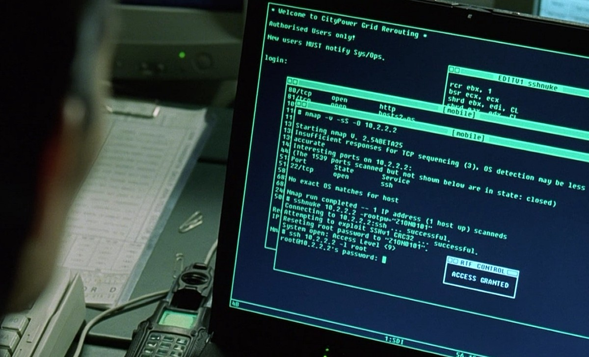
Nmap Basics

Slide 2
About Me :
Manish Sharma (Cyph70t)
LinkedIn : https://linkedin.com/in/cyph70t
Twitter: @cyph70t
GitHub: https://github.com/cyph70t
Discord: cyph70t@712

Slide 3
Today's Agenda
Features
How It Works
Scanning Techniques
Demo

Slide 4
Before we proceed...
Do You Think
Nmap is just a port Scanner ?

Slide 5
Features
Nmap was first published in September 1997
Included operating system fingerprinting
Service fingerprinting
Code rewrites (C to C++)
Additional scan types,
Protocol support
New programs that complement Nmap's core features

Slide 6
How Nmap Works
Sends TCP and UDP packets to the target machine
Examines the response by comparing the result with the database
OS detection involves the process of finding open ports
Ping scan uses ICMP packets to check live machines within the network
Nmap is not limited to merely gathering information and enumeration

Slide 7
What you do when you need help ?

Slide 8
Nmap Help !!!
nmap –h / --help

Slide 9
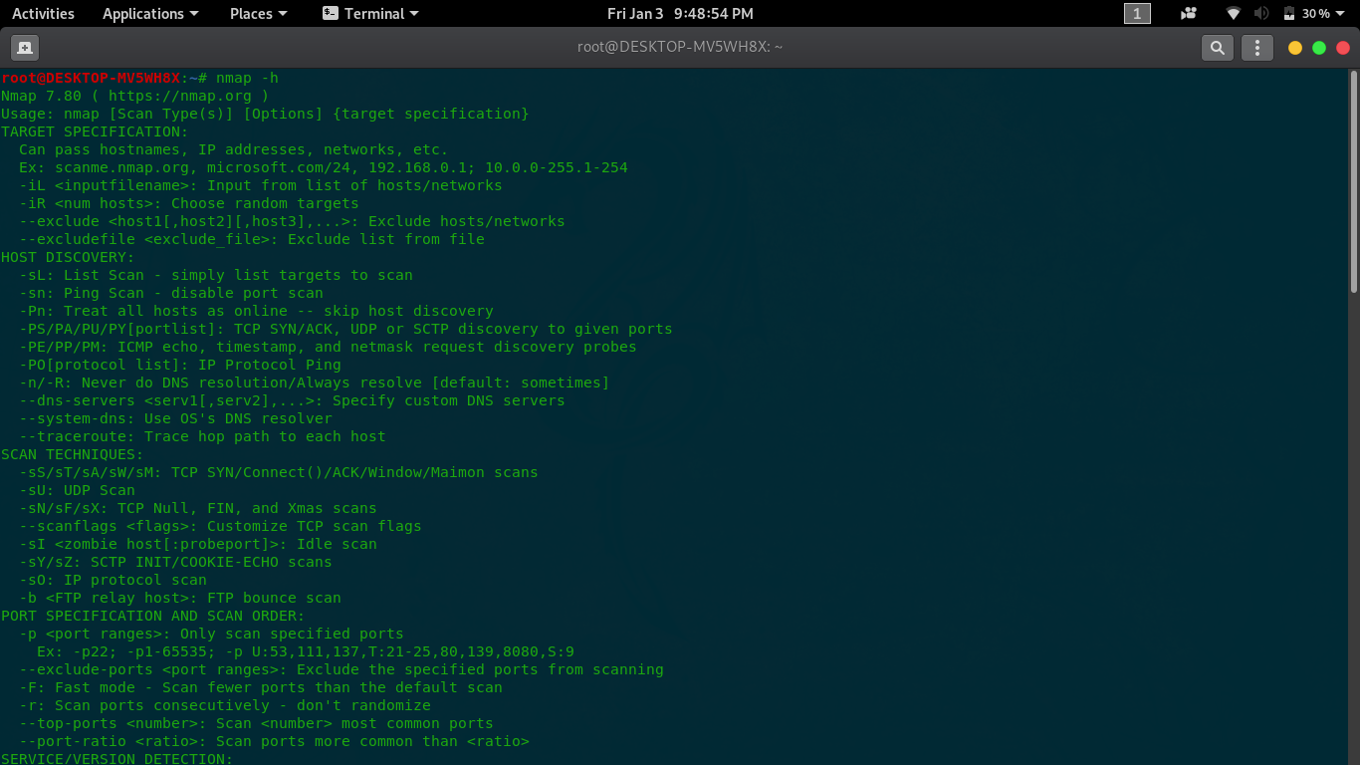

Slide 10
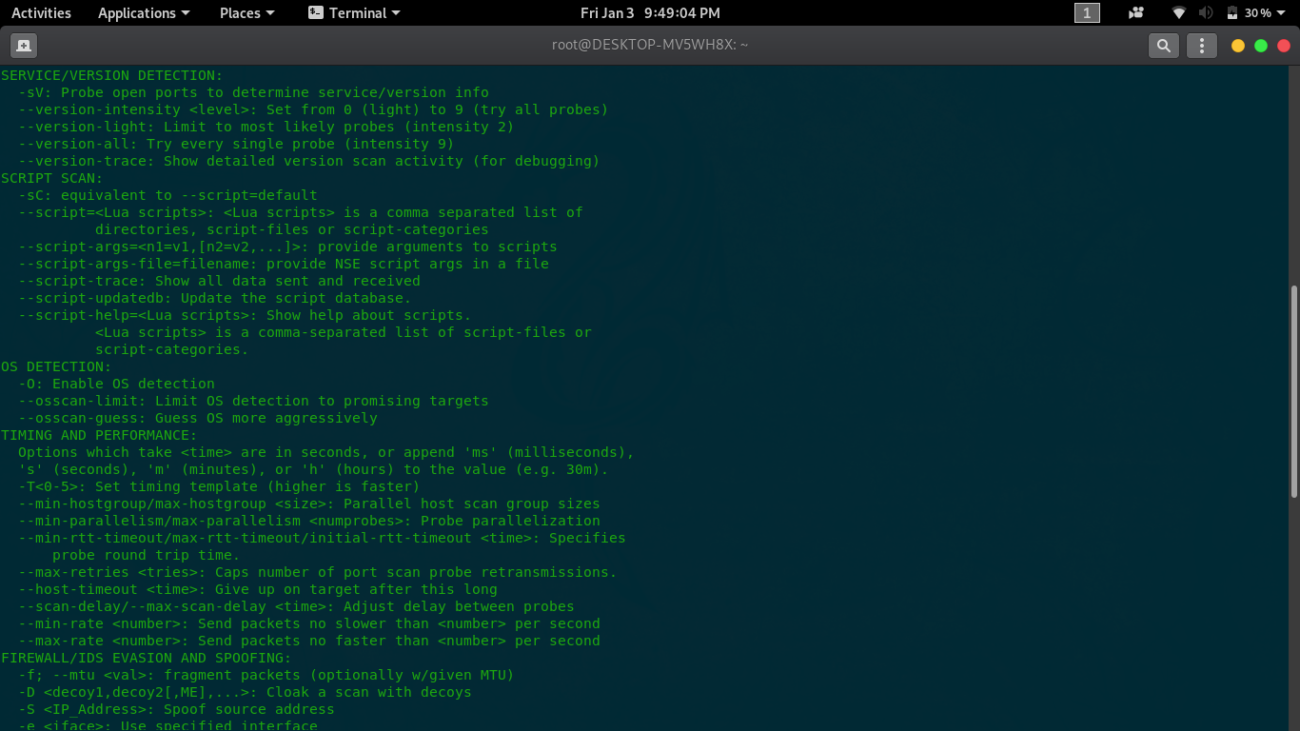

Slide 11
Scanning Techniques

Slide 12
Nmap –sT 192.168.0.110

Slide 13
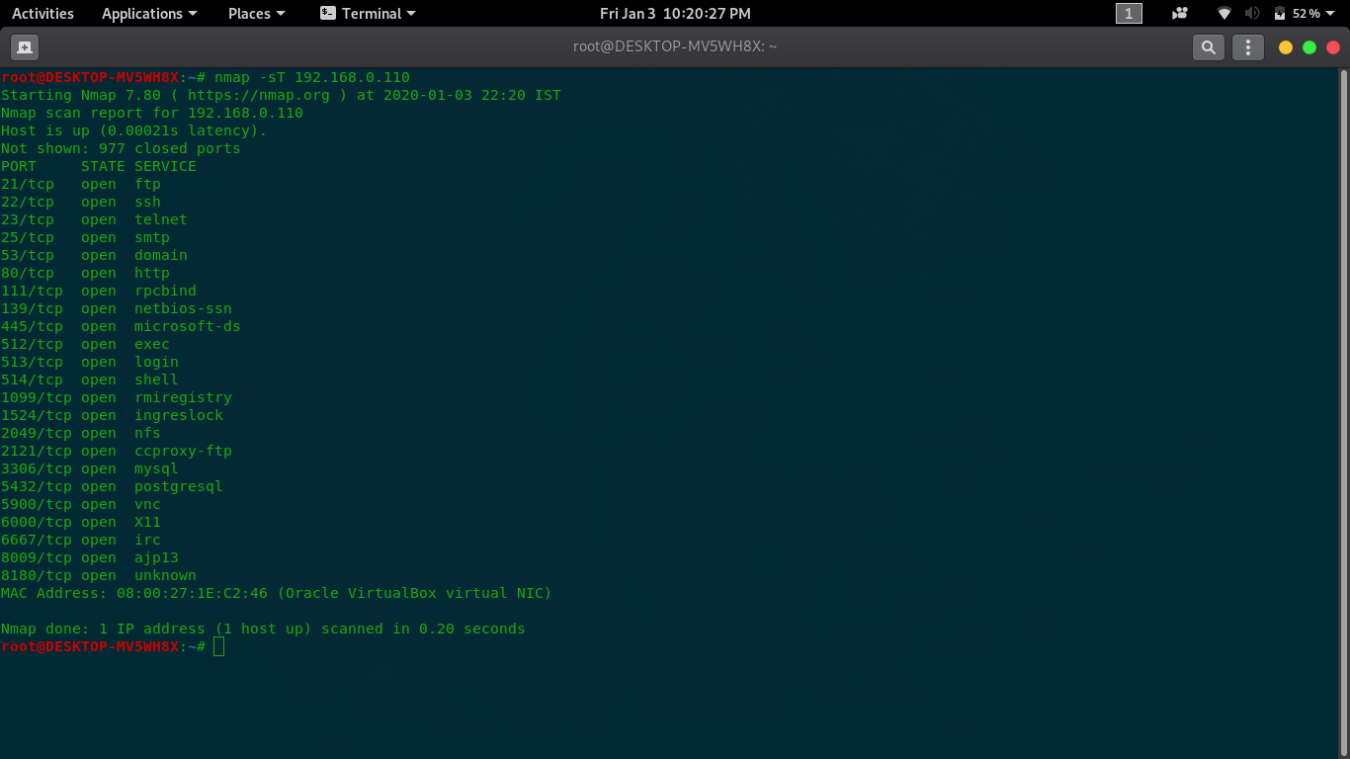

Slide 14
nmap –sF 192.168.0.110

Slide 15
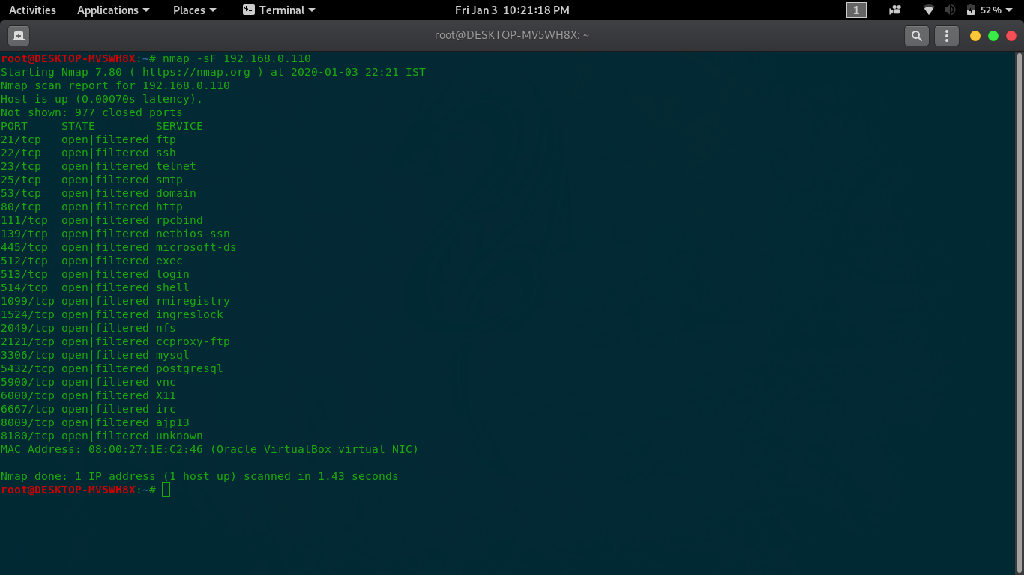

Slide 16
nmap –sS 192.168.0.110

Slide 17
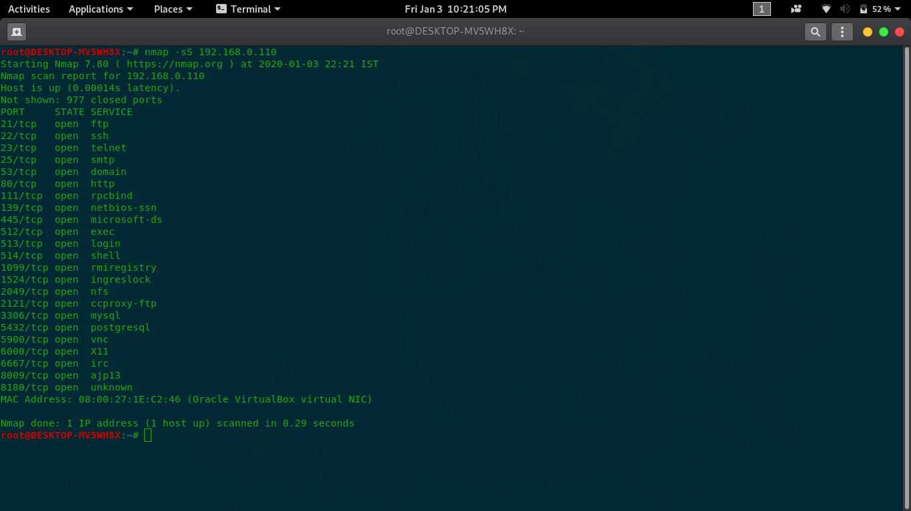

Slide 18
nmap –sU –T5 192.168.0.110

Slide 19
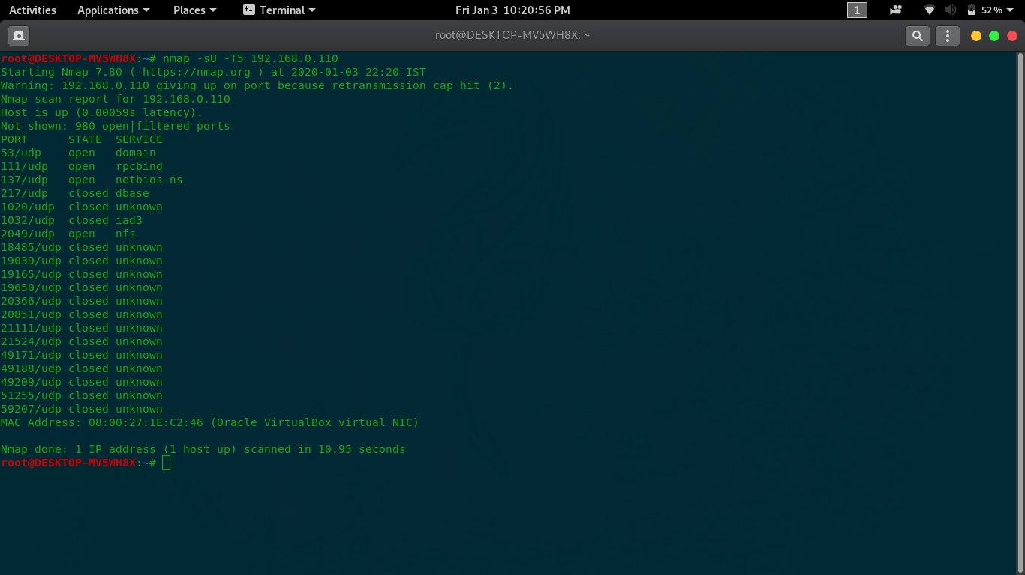

Slide 20
nmap –sV 192.168.0.110

Slide 21
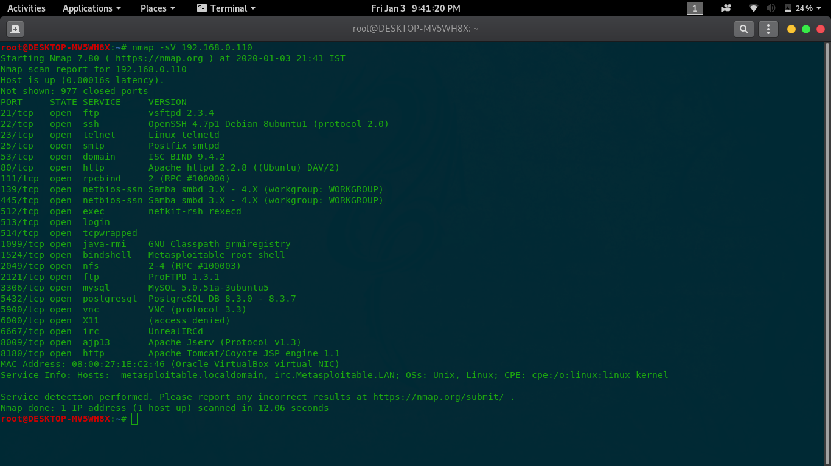

Slide 22
nmap –O 192.168.0.110

Slide 23
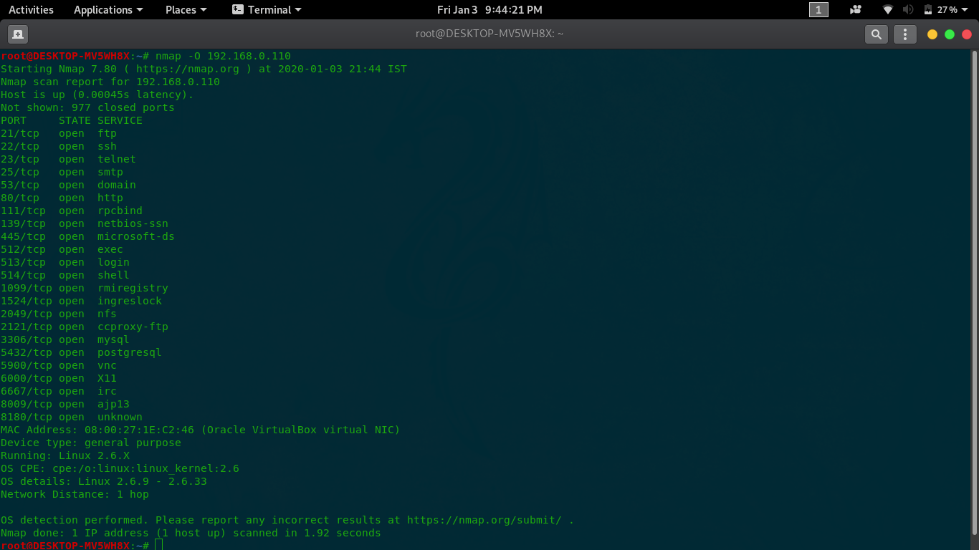

Slide 24
nmap –sV –sC –T5 192.168.0.110

Slide 25
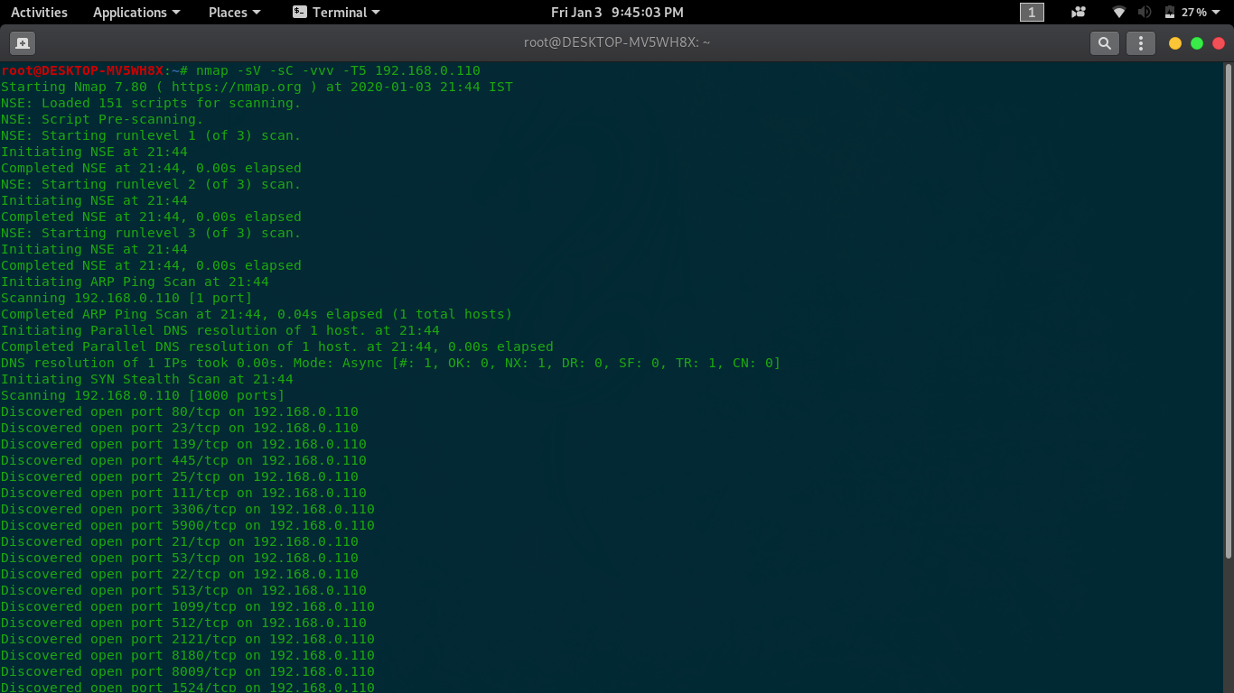

Slide 26
Nmap NSE(Nmap Script Engine)
NSE is one of Nmap's most powerful and flexible features
It allows users to write (and share) simple scripts to automate a wide variety of networking tasks.
Those scripts are then executed in parallel with the speed and efficiency you expect from Nmap

Slide 27
locate *.nse

Slide 28
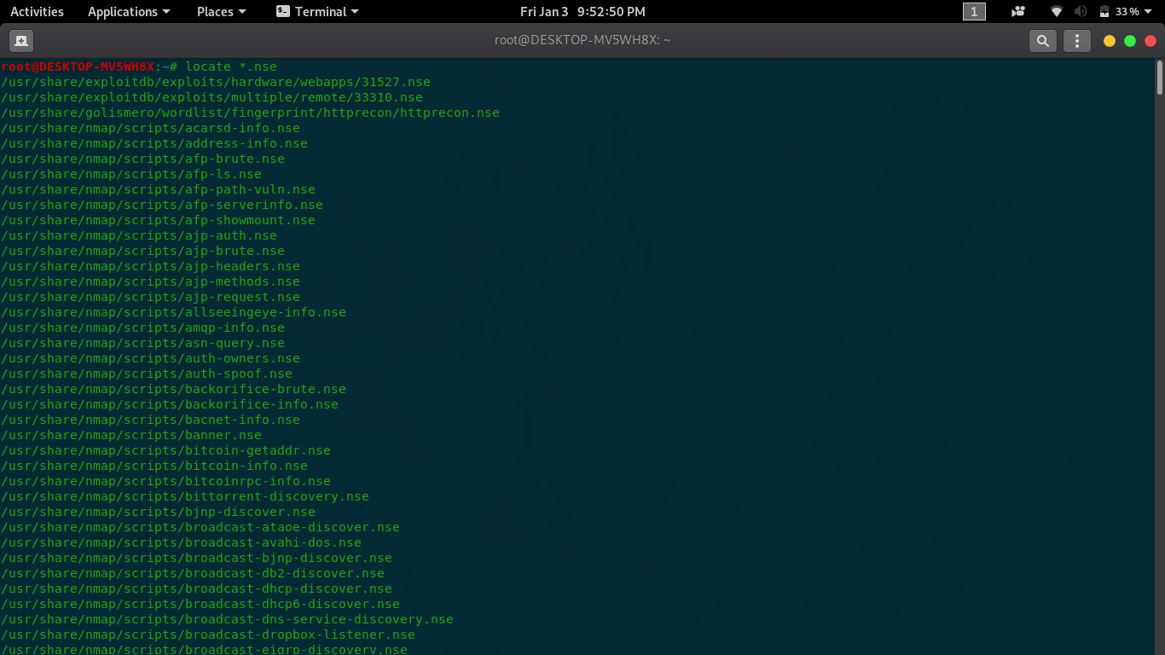

Slide 29
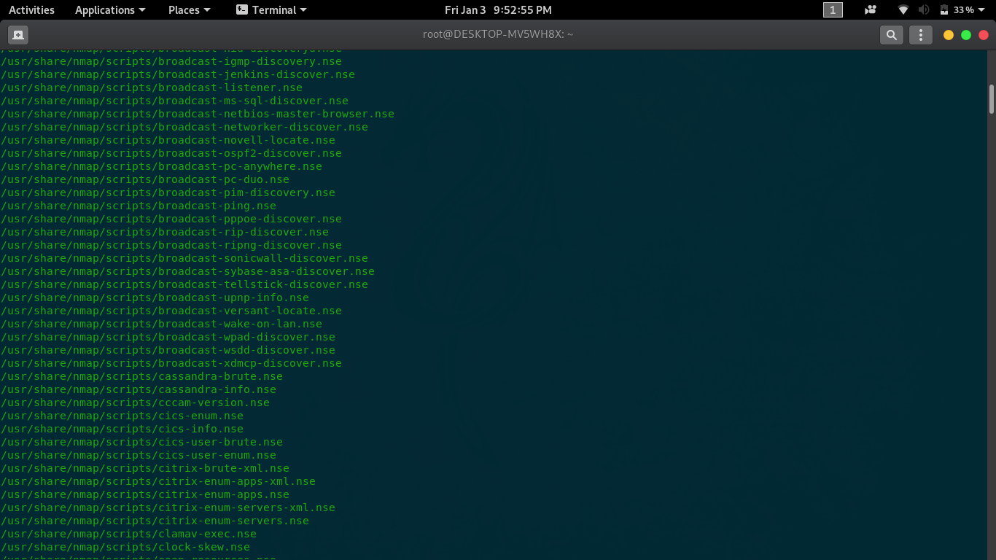

Slide 30
Bruteforce with Nmap ?

Slide 31
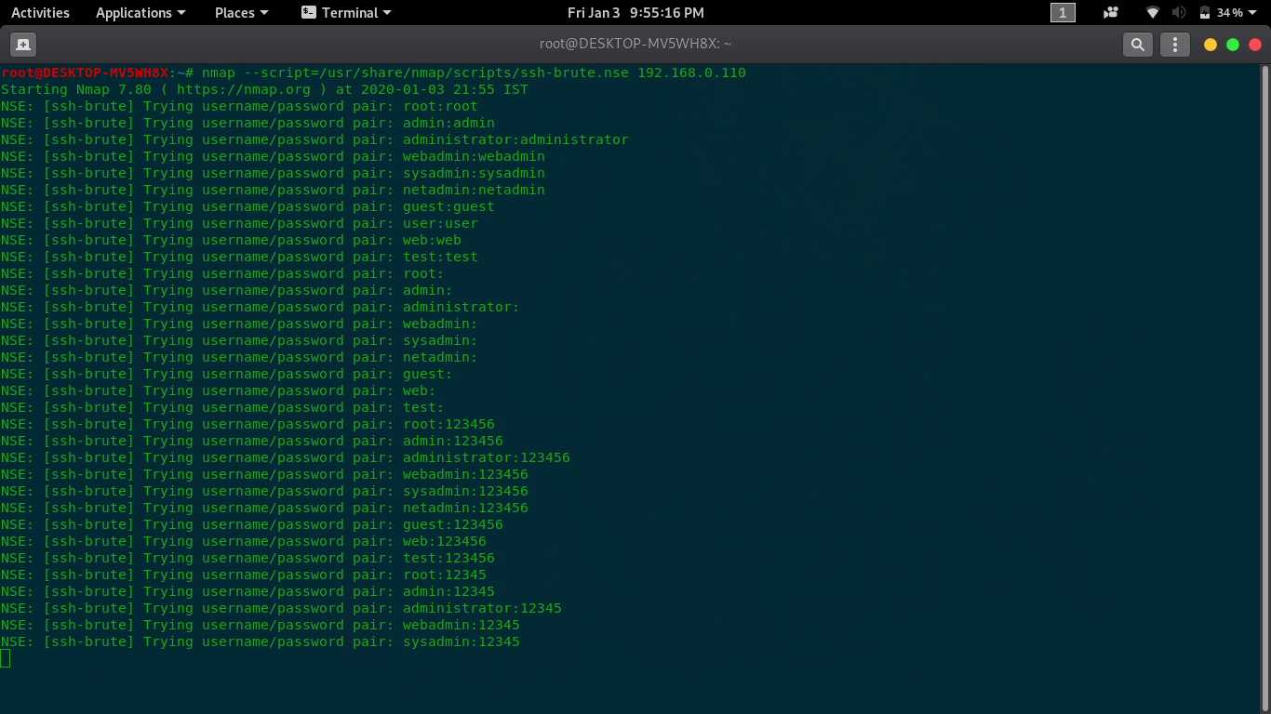

Slide 32
Vulnerability Scanning With Nmap !!!

Slide 33
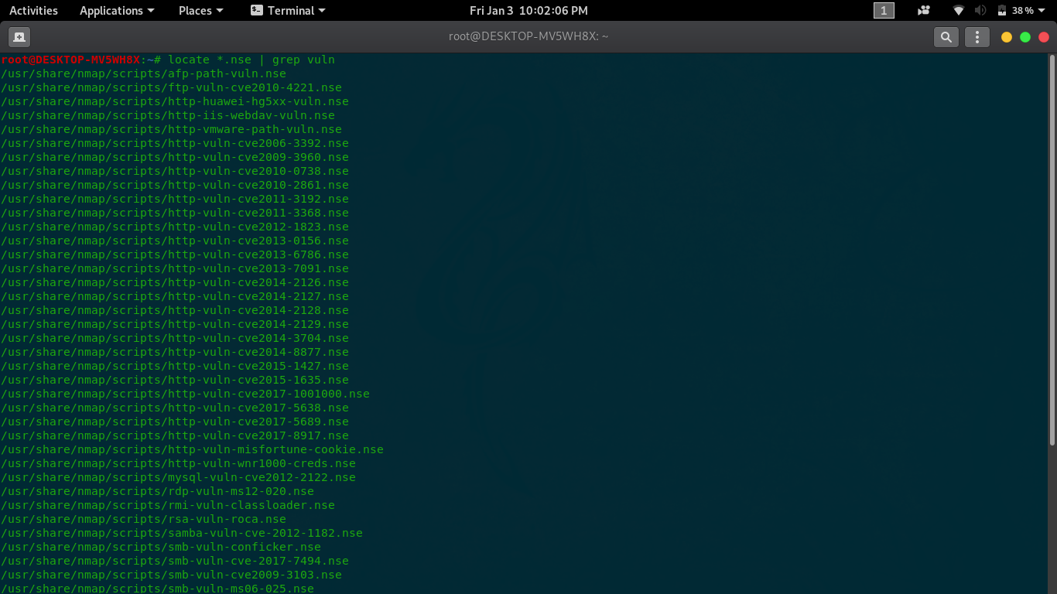

Slide 34
NSE for http

Slide 35
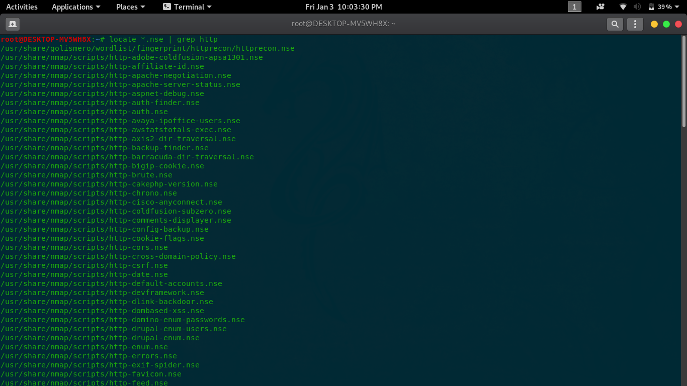

Slide 36
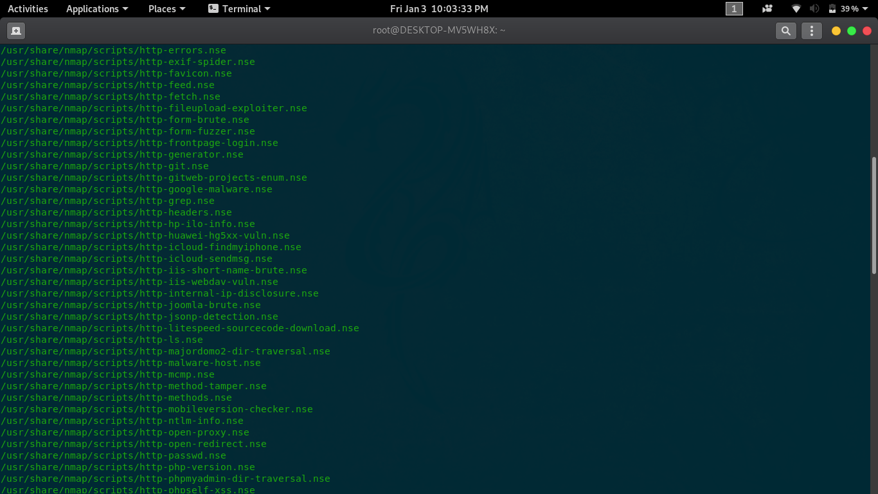

Slide 37
Let's Go with Few Demo !!

Slide 38
Thankyou
Any Questions ?

